Slide 1
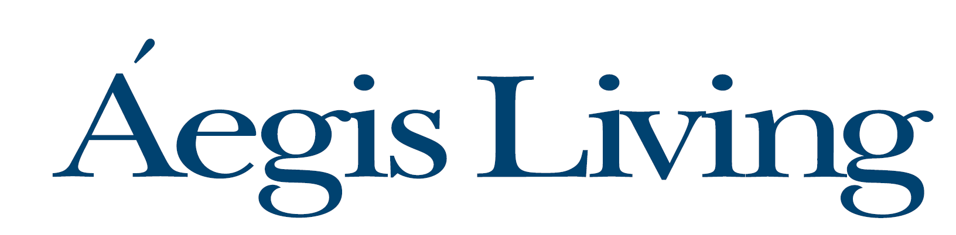
401k and New Company Matching Contribution
Open enrollment - Employee Benefits 2020-21
Presented by: Kim Stabler, Aegis Living
Hosted by: Annik Johnson, AssuredPartners MCM

Slide 2

401k
  Eligibility
  How is the Match Calculated
  Vesting in the Company Match
  How to Enroll
  Resources
Open Enrollment
  What is open enrollment?
  What’s changing on April 1?
  What do you need to do?
  Resources

Slide 3

401k Plan and New Company Match

Slide 4


401(k) Retirement Savings Plan Eligibility
Employees age 18 and older are eligible to participate in the Aegis 401k plan effective on the first day of the month following date of hire.
Find The Standard 401k Enrollment Guide at www.aegislivingbenefits.com/401k
Once eligible you may enroll in or make changes to your 401k contributions as often as every payroll.

Slide 5
Employee Contributions
You may contribute up to $19,500 in 2020
If you are age 50 or older in 2020, you may contribute $26,000
You may contribute pre-tax or Roth after-tax contributions or both
*minimum of five year period to contribute to Roth after-tax
Type of Contribution | How contributions are treated when made | Taxation when withdrawn at retirement (contributions and investment earnings)
Pre-tax | Payroll deductions deducted before taxes are calculated | At retirement (age 59-1/2 or later) withdrawals are taxed
Roth post-tax | Contributions deducted after taxes are calculated | At retirement (age 59-1/2 or later) withdrawals are tax-free*

Slide 6

401k Matching Contribution 2020
Aegis match will equal $.50 for each dollar you contribute up to 4% of your pay.
You are eligible for the match after one year of service
  (e.g., to be eligible for the 2020 match, you must have been hired on or before 1/1/2020)
The 2020 match will be made in 2021

Slide 7
How is the 401k Match Calculated?
Example 1 – Juan Juan contributes 3% of his 2020 salary of $35,000 ($40.38 each pay period). Aegis will match his contribution at 50%. | Juan’s Contribution $1,050 Aegis Match $ 525 Total $1,575
Example 2 – Anna Anna contributes 4% of her 2020 salary of $40,000 ($61.53 each pay period). Aegis will match her contribution at 50%. | Anna’s Contribution $1,600 Aegis Match $ 800 Total $2,400
Example 3 – Marco Marco contributes 6% of his 2020 salary of $45,000 ($103.84 each pay period). Aegis Living will match on 4% of his contribution at 50%. | Marco’s contribution $2,700 Aegis Match $ 900 Total $3,600

Slide 8
How is the Match Made?
You gain ownership of the company match, called “vesting,” over 5 years at the rate of 20% for each year of service, meaning you are fully vested after 5 years of service.
Example 1 (Juan)
Juan was hired January 1, 2020. He will have one year of service by the end of 2020. His match is $525.
$105 will immediately vest at 20%. The remaining $420 will vest over the next four years of service at the rate of 20% each year.
Example 2 (Anna)
Anna was hired January 1, 2018. Anna will have worked three years by the end of 2020. Her company matching contribution is $800.
$480 will immediately vest at 60%. The remainder of $320 will vest over the next two years of service at the rate of 20% each year.
You earn one year of vesting for each calendar year you work at least 1,000 hours.
Your service before 2020 counts.

Slide 9

Important Note
You must be employed on the last day of the calendar year in order to be eligible for the match.
If you leave Aegis before becoming 100% vested, you will lose any unvested portion of your match.

Slide 10
401k Match for 2019 Participants
If you contributed to the 401k plan in 2019, you will receive a matching contribution from Aegis, based on the same formula.
  $.50 for each dollar you contribute up to 4% of pay that you contribute to the plan.
However, vesting for the 2019 match is over a 6 year period, starting with 20% vesting after 2 years of service, and 100% vesting after six years of service.
Your service prior to 2019 will count towards your vesting.
The 2019 matching contribution will be posted to your 401k account April 2, 2020

Slide 11
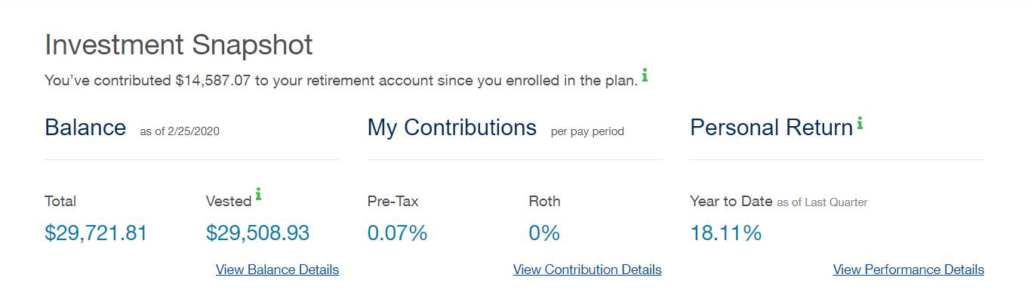
View Matching Contribution Online
Log on to your 401k account at The Standard website
  www.standard.com/retirement
  You will land on My Home Page
  Scroll down to “Go to My Account”
  Click on View Balance Details

Slide 12
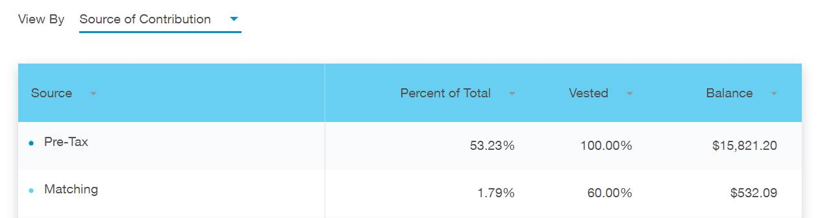
Viewing Matching Contribution Online
Under View By, Select “Source of Contribution”
You will see that employee Pre-tax tax contributions show 100% vesting
The matching contribution shows 60%.

Slide 13

How to Enroll in the 401(k)
You can register and enroll in the plan by going to www.standard.com/retirement.
If you need assistance, please contact The Standard at (800) 858-5420. Paper forms are also available at www.aegislivingbenefits.com/401k under Helpful Resources.
  Return those forms to your Business Office Manager.

Slide 14
Resources
Information about the Aegis 401k plan can be found online at the Aegis Living Benefits website at www.aegislivingbenefits.com/401k.
If you have questions about the matching contribution, please contact Kim Stabler in your HR Department at (425) 284-1613 or via email at kim.stabler@aegisliving.com.
For assistance with selecting investments, contact AssuredPartners MCM: Stephany Primitivo or Rich Hultquist at 206-343-2323

Slide 15

Open Enrollment

Slide 16

What is open enrollment?
The only time you can make changes to your health and welfare benefit elections without experiencing a life status event (e.g. marriage, birth, loss of other coverage, etc.)
You can add, drop, or change coverage for yourself and/or eligible dependents for:
  Medical insurance
  Dental insurance
  Vision insurance
  Supplemental life and AD&D
  Enroll in a Flexible Spending Account
Open enrollment is March 2 -16
Changes effective April 1
Notes:
Birth or adoption of a new child
The death of a dependent
Marriage, divorce or legal separation
Loss of child eligibility because of age or marriage
Spouse gains or loses coverage through his or her employment
A significant change in the financial terms of benefits provided through a spouse’s employer
Loss or gain of employee eligibility due to a change in hours worked

Slide 17

What to expect during open enrollment
Enrollment packet - mailed to your home address by March 2
Includes:
  Personalized enrollment forms
  Description of your benefits, changes and cost
If you don’t get an enrollment packet by Thursday, March 5, contact your Business Office Manager.

Slide 18

Who is eligible for benefits?
Full-time employees working 30 hours/week
Wellness nurses working 24-29 hours/week
If you are eligible and decide to enroll in benefits, you may also cover the following dependents:
  Your lawful spouse
  Your same-sex or opposite-sex domestic partner*
  Your dependent children up to age 26, regardless of marital or student status
  Your disabled children, regardless of age, who are physically or mentally incapable of self-support
* If you are newly adding a domestic partner, please complete the Domestic Partnership Affidavit. Request it from your BOM or find it at www.aegislivingbenefits.com/openenrollment

Slide 19
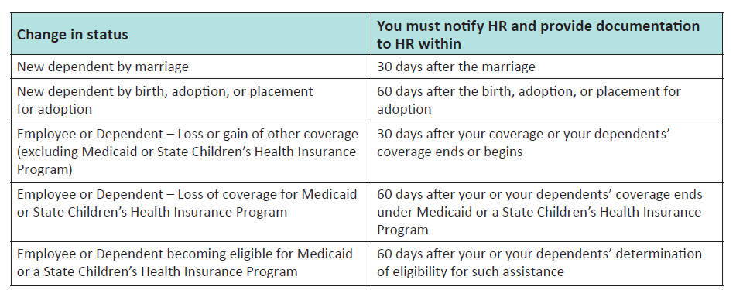
When can changes be made?
Health & Welfare Benefits
  During open enrollment in March (changes are effective April 1)
  During the year if you experience a change in status
In most cases, coverage will take effect the first of the month coinciding with or following your change in status.
401k – once eligible, you may enroll or make changes at any time

Slide 20
What’s changing?

Slide 21
Cost of coverage
Medical and dental:
  We’re excited to announce that for the sixth year in a row, your cost for health insurance premiums will not increase.
  Over the last six years across America, employee contributions for medical and prescription drug coverage have increased by an average of 19%. Aegis will absorb the cost increase for 2020-21!
Dental and Vision:
  Dental contributions will not change
  Your cost of vision coverage will increase slightly.
98point6 – on-demand primary care
  Aegis will continue to pay the cost of coverage for 2020-21.
See the Cost of Coverage page in the Benefit Guide for the medical, dental, and vision employee contributions and the Supplemental Benefit Enrollment Form for the life and AD&D cost.

Slide 22


Medical plans
More good news! The copay for physician office visits will decrease.
*The copay for freestanding urgent care centers will remain $35 on the Core Plan and $30 on the Buy-Up Plan.
Plan | In-Network Physician Office/Clinic Visits | Current | 2020
Core Plan | Primary care physician, specialist, acupuncture, chiropractor, outpatient mental health, rehabilitation therapy | $35 copay | $20 copay
Buy-Up Plan |  | $30 copay | $20 copay

Slide 23


Flexible spending account (FSA) changes
Maximum contribution for the health care FSA is increasing to $2,750 for 2020. (Set by the IRS)
Health Care FSA Contribution
  Minimum $100, Maximum $2,750
Dependent Day Care Care FSA Contribution
  Minimum $500, Maximum $5,000
Plan year for FSA’s is April 1 – March 31, with 2.5 month grace period to incur claims (through June 15, 2021)

Slide 24
What you need to do for open enrollment

Slide 25

Paperwork for Employees
Review
Open Enrollment Announcement
Benefits Guide
Benefits Enrollment Form and Supplemental Benefits Enrollment Form (prefilled with current elections)
Complete a:
Benefit Enrollment Form- only if making changes
Supplemental Benefits Enrollment Form - only if making changes
  Any new enrollment or change to employee and spouse supplemental life will require a Personal Health Application (PHA), which will be mailed to your home address.
FSA Enrollment Form, if you want to enroll for a health or dependent care FSA for the 2020-21 plan year
  2019-20 elections do not roll over to 2020-21.
  Return to your Business Office Manager no later than Monday, March 16th

Slide 26
Affordable Care Act reminder
If you are eligible for the Aegis Living medical plan you are unlikely to qualify for a premium tax credit for individual coverage purchased through a health insurance marketplace (e.g. Washington, Healthplanfinder, Covered California, Nevada Health Link).
Why is that?
  Aegis Living offers medical, coverage that meets the ‘adequacy and affordability’ requirements under the Affordable Care Act, (ACA).
  Employees that are offered coverage by a plan that is defined as ‘adequate and affordable’ are not entitled to the premium tax credit.
If you receive a premium tax credit in error, you will likely have to repay it when you file your federal tax return.
  Tax credit amounts depend on your household income and family size.
  Example financial help for a family of 4 on a Silver plan in WA (actual costs may vary):
Household Income | You Get (federal tax credits) | You Pay (After-tax credits)
Less than $32,500 | Medicaid pays for coverage | Coverage is free
$40,000 | $5,100 annually | $1,968 annually

Slide 27

Business Office Manager To-do’s
Post the open enrollment poster
Make sure open enrollment is announced at your community
Notify Kim Stabler if an employee doesn’t receive their enrollment packet by Thursday, March 5
Remind employees mid-way through open enrollment and again March 13
Gather and check forms before sending to home office
March 16 employee enrollment deadline is firm (end of day)
This Photo by Unknown Author is licensed under CC BY

Slide 28
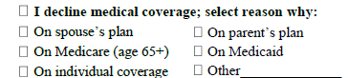
Checking enrollment forms
We need help from our Business Office Managers to process enrollment forms.
The employee must use the pre-printed form in their packet.
Please check each form before sending to Home Office. Instructions are included on the Benefits Enrollment Form
  Section 2 – Enter Employee SSN
  Section 4 – Check the box - must be completed (change or no change)
  Section 5
    If making changes, make elections for all benefits.
    If waiving medical coverage, employee must also select reason why declining:
  Section 6 - If adding or removing dependents or benefits for dependents, make those changes here. All fields must be complete.
  Make sure the form is signed and dated on side 2.
  Make sure the form is legible.
  Make sure information matches (e.g., if a dependent is enrolled or removed from coverage, check appropriate boxes in Section 6 (Dependents) on side 2

Slide 29
Completed Enrollment Forms
If an employee is newly enrolling, making changes and/or enrolling for the FSA for 2020-21,
  Scan forms and send them to Kim Stabler.
  Scan individually and the use the naming convention for forms as follows:
      34033, Stabler, Kimberly OE 2020
If an employee is not making changes, retain the form for your files. If unsure send them to Kim.
Please keep all originals. Don’t send them to home office.
Send immediately. Do not hold forms until the end of open enrollment.

Slide 30
Newly Eligible Employees
New hires effective March 1
For March 1 enrollment, provide a 2019-20 enrollment packet
Open enrollment - They will receive an open enrollment packet.They can make changes for the new plan year which starts April 1.
New hires effective April 1
For April 1 enrollment, please only provide a 2020-21 newly eligible employee packet (available soon).
They do not have open enrollment.

Slide 31

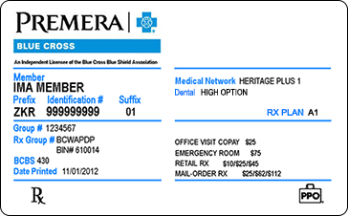
ID cards
Medical/Rx with Premera
  Everyone enrolling in a medical plan will receive a new Premera ID card. It will be mailed to your home address in early April.
Dental with Delta Dental of WA
  If you newly enroll in the dental plan you will receive a Delta Dental of WA ID card. It will be mailed to your home address in early April.
Vision with VSP
  Cards are not issued by VSP. You may register at www.vsp.com to search for providers and get coverage information.
Navia FSA
  If you enroll in a health care FSA for the first time you will receive a Navia debit card in the mail. It will be mailed to your home address in early April.
  If you are currently enrolled in a health care FSA you can keep using your Navia debit card until it expires.

Slide 32
Resources

Slide 33

Aegis Benefits website
Access benefit information online at www.aegislivingbenefits.com/enrollment
Why go online?
  Benefit Guide
  Benefit summaries and plan documents
  Search for providers
  Links to vendors
  And more!
Notes:
You can call your local HR department with any questions

Slide 34


AssuredPartners MCM Employee Service Center
Benefit Advocates are available to you at AP MCM, our benefit consulting firm
  Phone: 7:30am to 5:00pm Monday through Friday
  1-888-343-3330 or mcm.aegis@assuredpartners.com
  Language interpretation services available in 200+ languages
  The ESC can help with the following:
    What are my benefits?
    I’m having problems with my pharmacy.
    Why was my claim denied or only partially paid?
    How do I get help resolving old or unpaid bills?

Slide 35

Questions?

